Slide 2
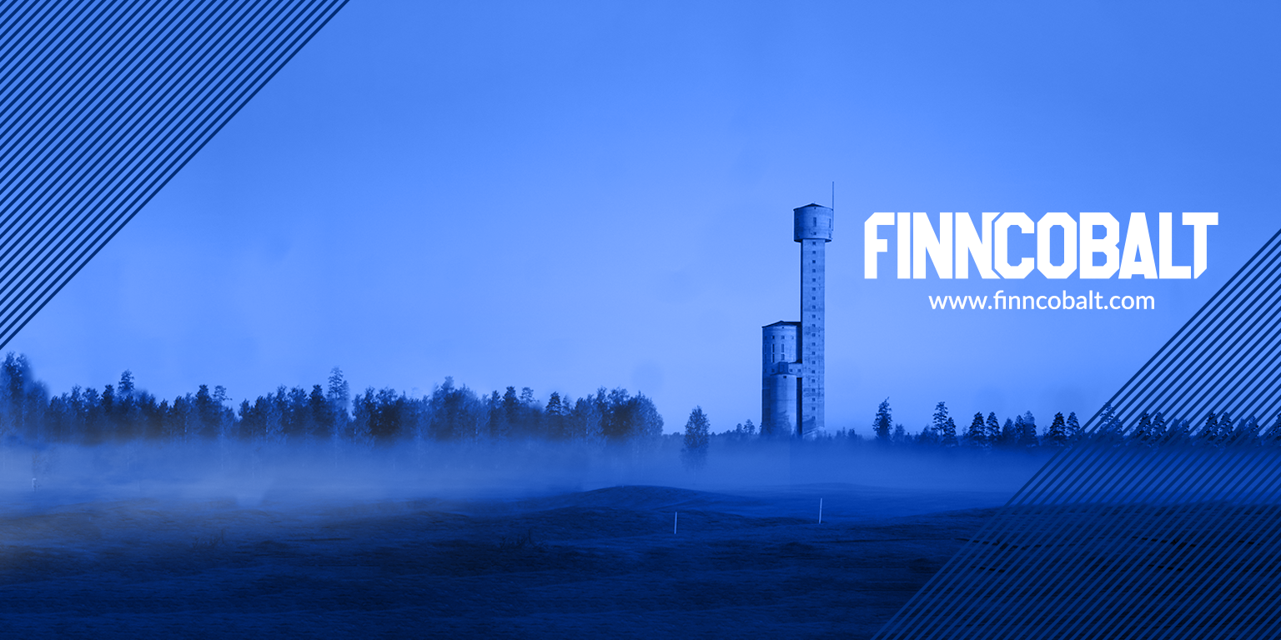
A Eurobattery Minerals Company
Hautalampi Cu-Ni-Co-mine Project,
ESG REPORT 2025
2.2.2026
4.2.2026
2
Notes:
2

Slide 3
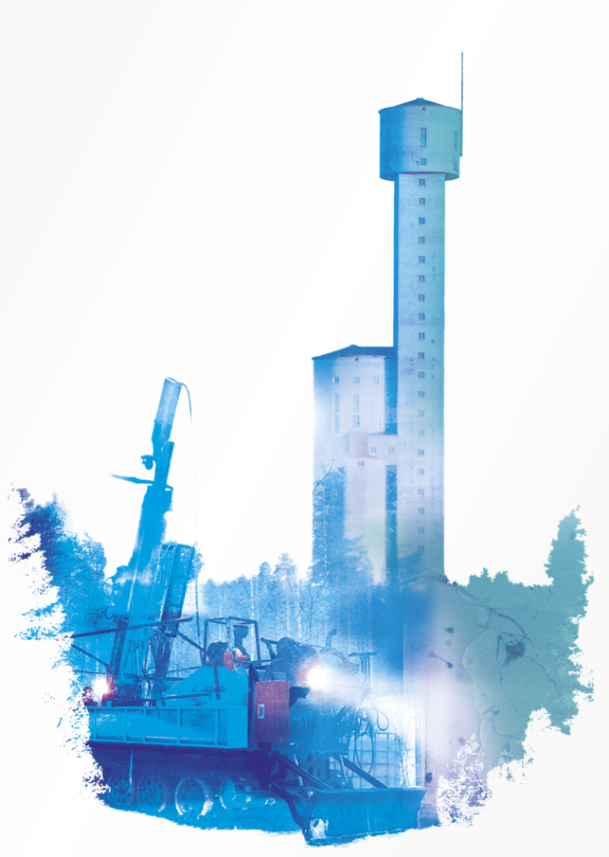

Sustainability at Finncobalt Oy
As a forward-looking mining company, FinnCobalt takes full responsibility for the environmental, social, and governance impacts of its operations. We are committed to ethical conduct, respect for biodiversity, fair treatment of all people, and fulfilling our commitments. Our goal is to be a trustworthy employer and operator, delivering sustainability actions that we can look back on with pride for years to come.
FinnCobalt’s sustainability framework guides both short- and long-term development. Key focus areas include employee well-being and safety, environmental protection, emissions & waste reduction, efficient water use, biodiversity-conscious restoration, and embedding sustainability into all aspects of our business and strategic planning. The 2025 Sustainability Report is our first report of this kind. It includes updated information on our sustainability program, reflecting the most relevant topics identified through our analysis. Throughout 2026, we will continue implementing and refining action plans to meet both immediate and long-term planned objectives, with priorities including CO2 emissions, water management, biodiversity, employee welfare, community engagement, and strong governance practices.
Ethical and responsible practices guide everything we do. Our Code of Conduct defines the principles that all employees should follow in interactions with colleagues, stakeholders, communities, and the environment. Operations are guided by company policies and guidelines, approved by management and applied consistently across the organization. Partners and suppliers are expected to adhere to ethical standards aligned with our Code of Conduct.
We foster a culture of collaboration and shared values in daily operations, creating value for our customers and Finnish society. FinnCobalt strives to be an attractive and responsible employer, supporting the well-being, equality, and professional development of our employees while ensuring that sustainability is embedded into all our activities.
Our Sustainability Vision
FinnCobalt aims to lead in defining and achieving sustainability goals. We seek to be a profitable and responsible investment for our owners and a desirable employer for our workforce. As the demand for responsibly produced metals grows, we continuously enhance our operations to ensure sustainable mining practices remain at the core of our business and strategy.

Slide 4
Our Values and Culture
Health & Safety at the workplace
At FinnCobalt, the safety and well-being of our employees, contractors, and surrounding communities are the key values of our operations. We implement safety protocols, provide continuous training, and maintain a proactive safety culture to prevent accidents and protect everyone on site. The company's philosophy is that all injuries can and must be prevented, aiming for a world-class safety culture.
Diversity
We are committed to fostering a diverse and inclusive workplace where all individuals are respected, valued, and given equal opportunities to grow. Collaboration, open communication, and mutual respect form the foundation of our corporate culture, ensuring that every team member can contribute to our shared goals.
Environment
Environmental stewardship is a core principle of our planned mining activities. Mining can, and must, be done responsibly. We actively manage our environmental footprint, implement efficient resource use, and minimize emissions and waste. Sustainable practices are integrated into every stage of our projects, from planning and exploration to production and closure, reflecting our responsibility to current and future generations.
FinnCobalt continuously monitors its performance across health, safety, diversity, workplace, and environmental metrics, setting ambitious targets and taking concrete actions to meet them. By combining strong governance with social and environmental responsibility, we aim to create lasting value for our stakeholders and the communities in which we operate.

Slide 5
FinnCobalt´s Sustainability Program
FinnCobalt’s Sustainability Program guides how we develop the Hautalampi battery mineral project and how we operate as a responsible mining company in Finland. It translates our principles into concrete priorities, commitments and actions. We see ESG as a commitment to environmental protection, meaningful engagement with communities to build social acceptance, and responsible governance supported by robust Health & Safety standards. The program is therefore built on three pillars — environment, community, and people — and is fully aligned with the Towards Sustainable Mining (TSM) framework and the UN Sustainable Development Goals most relevant to our operations.
Environment: Minimising Impact & Protecting Nature
We commit to responsible environmental management throughout the entire life cycle of the Hautalampi project — from exploration to mine closure and restoration.
Our focus areas include:
Biodiversity protection through nature and wildlife surveys.
Responsible land use and sustainable forest management.
Water stewardship, including continuous monitoring of groundwater, surface water, fish and benthic organisms.
Minimising our carbon footprint and improving energy efficiency.
Modern, low-impact mining technologies that reduce the need for blasting and minimise surface disturbance.
Long-term mine closure planning, ensuring the area is restored and safe for future generations.

Slide 6
FinnCobalt´s Sustainability Program
People: Safe, Healthy and Inclusive Workplaces
We strive to create a working environment where every employee, contractor and partner can work safely and with dignity.
Our focus areas include:
Zero-harm culture, with strict health and safety protocols.
Respect for human rights, including a firm commitment to preventing child and forced labour.
A diverse, equal and inclusive workplace where everyone is treated fairly.
Strong crisis management and preparedness, following TSM protocols.
Continuous training and competence development for our people and partners.
Communities: Local Value, Trust and Long-Term Benefits
We believe that responsible mining must benefit the community where it operates. Our commitment is to work openly, respectfully and collaboratively with the people of Outokumpu and the wider region.
Our focus areas include:
Local content policy: prioritising regional suppliers, service providers and workforce whenever possible.
Open and transparent dialogue with community members, authorities and stakeholders.
Support for community well-being, local initiatives and long-term regional development.
Predictable and responsible operations that strengthen trust and contribute to a vibrant local economy.

Slide 7
FinnCobalt´s Sustainability Program
FinnCobalt’s Sustainability Program is continuously monitored, evaluated and improved through:
Annual sustainability reporting via the Towards Sustainable Mining framework (TSM).
TSM external verification.
Engagement with local communities and key stakeholders.
Internal audits and compliance checks.
Clear objectives, timelines and KPIs for each sustainability area.
Our ambition is to set a high standard for responsible battery mineral production in Finland — meeting Europe’s growing demand for critical minerals while prioritising environmental protection, community well-being and responsible operations.

Slide 8
FinnCobalt´s Sustainability Goals
At FinnCobalt, our sustainability goals guide every stage of the Hautalampi Mine project — from exploration to future production and closure. Our aim is to ensure that responsible mining creates long-term value for people, the environment, and society.
Minimise environmental impact throughout the project lifecycle
Reduce land use disturbance and protect local biodiversity.
Continuously lower our CO2 footprint through efficient operations and clean technologies.
Ensure responsible water stewardship through systematic monitoring and protection of surface, ground, and discharge water.
Minimise waste generation and maximise circular use of materials, including extensive underground backfilling and reduced surface disposal.
Ensure a safe, healthy, and respectful workplace
Maintain zero serious accidents as our long-term target.
Promote wellbeing, diversity and equal opportunities for all employees and contractors.
Foster a transparent safety culture where every individual is empowered to speak up.
Strengthen community trust and local value creation
Prioritise local suppliers, contractors, and service providers whenever possible.
Engage openly with local residents and stakeholders, listening to their concerns and expectations.
Ensure that the community where we operate also benefits from the project — economically, socially, and through shared development.
Uphold the highest standards of ethical and responsible business conduct
Comply fully with TSM protocols and all Finnish regulations.
Operate transparently and maintain strict zero-tolerance towards child or forced labour in any part of the value chain.
Follow best international practices for exploration, mine closure planning and long-term environmental management.
5. Contribute to a sustainable, resilient European raw materials supply
Support the EU’s goals for secure, traceable, responsibly produced critical raw materials.
Develop a modern mining project that supports the transition to cleaner technologies and a carbon-neutral future.

Slide 9
Comment from the FinnCobalt´s CEO
Dear stakeholders,
At FinnCobalt, sustainability is more than a chapter in this report — it is the foundation of everything we do guiding our environmental, social and governance commitments. As custodians of the Hautalampi mine project in the historic mining area of Outokumpu, we carry a responsibility that goes far beyond the boundaries of our operations. We are part of a larger European effort to secure responsible access to the critical raw materials that power the sustainability transition.
This past year, we have strengthened our commitment to transparency, environmental stewardship and community engagement. From rigorous environmental monitoring to open dialogue with local stakeholders, we continue to operate with the highest European standards in mind. Our goal is clear: to demonstrate that mining can and must be carried out ethically, with respect for nature and people, supported by strong governance and robust health and safety practices, while contributing to Europe’s climate and industrial ambitions.
The global demand for responsibly sourced cobalt, nickel, and copper is increasing. For us, however, success is not measured solely by the resources we produce, but by how we produce them. Carbon-zero mining ambitions, together with waste minimisation and circular use of materials, are not distant aspirations; they are guiding principles that already shape our decisions today and over the long term.
We are proud of the progress made, yet we recognize that sustainability is a continuous journey. Together with our partners, local communities and shareholders, we will continue to deepen our efforts, innovate and lead by example in Finland and beyond.
Thank you for your trust in FinnCobalt. We look forward to building a responsible, resilient and sustainable future — one step, and one ton of critical minerals, at a time.
Ilari Kinnunen
CEO, FinnCobalt Oy

Slide 10
Sustainability in 2025
Objectives for 2025
Zero workplace accidents
Further development of measures to reduce the future carbon footprint of mining operations
Active monitoring of metal concentrations in groundwater
Biodiversity monitoring in the Ruutunjoki River and Lake Sysmäjärvi, including metal and oxidation parameters
Active stakeholder engagement, including public meetings to inform local communities and provide opportunities to raise questions and concerns
Maintaining strong governance practices
Results in 2025
Zero workplace accidents were recorded
Progress was made in planning measures to reduce the project’s carbon footprint, including practical options for the use of CO₂-free energy and preparations for a fully electrified mining fleet.
Groundwater and surface water sampling was conducted, supported by an established monitoring programme with sampling carried out four times per year
Benthic fauna surveys and assessments were completed in the Ruutunjoki River
Various public community and stakeholder meetings, supporting open dialogue with the local community
Both internal and external communication practices were further strengthened

Slide 11
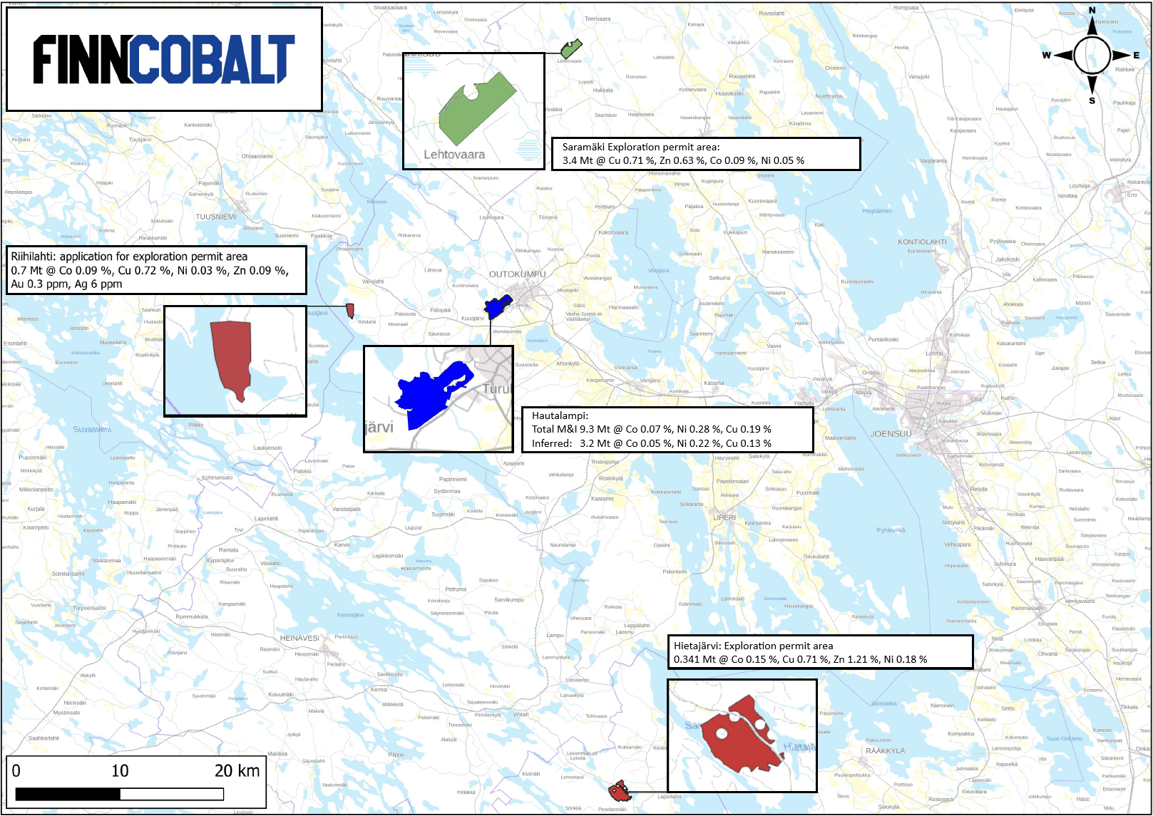
Land usage
Within our mining concession areas, we have carried out forest management activities to support ecological balance, promote biodiversity, and ensure responsible land stewardship.
In 2025, we received exploration permits for the Saramäki area in Polvijärvi and the Hietajärvi area in the Savonlinna region. In addition, we have submitted an exploration permit application for Riihilahti in Outokumpu. These permits allow us to conduct further exploration in the near future.
All of these areas are known to host Outokumpu-type mineralisation, including copper, cobalt, zinc, silver, and gold. By leveraging historical data from these sites, we can conduct exploration more efficiently and in a more environmentally friendly way.
Mining claims, Exploration permit, reservations in 2024
Hautalampi mining permit area 262 ha
Explotation permits 402 ha
Exploration permit applications 80 ha
Resevation notifications 0 ha
Exploration permits
Saramäki 176 ha
Hietajärvi 226 ha
Exploration permit application
Riihilahti 80 ha

Slide 12
Environmental Stewardship &
Impact Prevention
FinnCobalt proactively monitors and manages the environmental aspects of its planned mining operations to support sustainable and responsible resource development. Comprehensive groundwater monitoring has been completed, and the results are publicly available to ensure transparency and keep stakeholders informed about local water conditions.
To support responsible project planning and impact prevention, FinnCobalt has developed advanced environmental tools, including a three-dimensional groundwater model and updated dust dispersion assessments. These tools enhance our ability to understand environmental conditions, anticipate potential impacts, and implement effective mitigation measures throughout the project lifecycle.
Protecting biodiversity is a key priority for FinnCobalt. An updated Natura 2000 assessment for Lake Sysmäjärvi has been completed, incorporating the latest ecological data to ensure that protected habitats and species are fully considered. Long-term aquatic monitoring continues in accordance with the approved research programme, with the next fish resource monitoring phase scheduled for 2027.
Together, these actions reflect FinnCobalt’s commitment to environmental stewardship, transparency, and continuous improvement. Through science-based monitoring and responsible planning, we aim to minimize environmental impacts, protect natural ecosystems, and support surrounding communities over the full lifecycle of our projects.

Slide 13
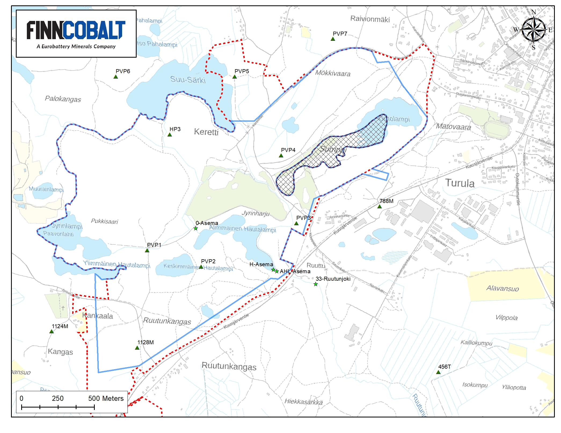
Environmental Monitoring Programme
Protecting the environment is one of FinnCobalt’s core values. To support this commitment, we have installed seven groundwater monitoring wells within the Hautalampi mining concession and its surrounding areas. These monitoring points form a key part of our environmental monitoring programme, with groundwater samples collected on a regular basis to track baseline conditions and detect potential changes over time.
The monitoring programme also includes surface water quality monitoring and water flow measurements. These activities are carried out both within the Hautalampi concession area and in the Ruutunjoki River, ensuring coverage of upstream and downstream conditions.
In addition to water monitoring, FinnCobalt conducts broader environmental observation and area surveillance activities to support biodiversity protection. These include fauna and habitat observations, monitoring of avian species in the project area, and field-based ecological surveys carried out as part of baseline studies and ongoing assessment work.
The results of environmental monitoring are published annually on FinnCobalt’s website. The expanded monitoring network and observation activities have significantly improved the availability and quality of environmental data for the area, strengthening our understanding of local conditions and supporting responsible project planning and long-term environmental stewardship.

Slide 14
Exploration
FinnCobalt holds three exploration areas located in nearby regions: two in North Karelia and one in the Savonlinna region. Exploration activities are guided by the principles set out in FinnCobalt’s Code of Conduct, with respect for the environment, responsible land use, and transparent engagement forming the foundation of all work.
Although these areas were previously explored and drilled by Outokumpu between the 1960s and 1980s, further exploration potential remains. FinnCobalt applies modern exploration methods, including participation in research initiatives, to improve geological understanding while aiming to minimise environmental disturbance and land-use impacts.
The company’s current exploration focus is the Saramäki mineralisation in Polvijärvi. Preliminary estimates indicate the potential presence of approximately 3–5 million tonnes of copper- and cobalt-bearing mineralised rock. The area has been studied in 2025 cooperation with the Geological Survey of Finland (GTK) as part of the DeepBEAT research project, which aims to improve understanding of deep-seated mineral systems using modern geological and geophysical approaches. Subject to further studies, the Saramäki mineralisation may be evaluated as a potential satellite deposit, with mineralised material processed at the planned Hautalampi facility.
Stakeholder engagement is an integral part of exploration activities. During the summer, FinnCobalt, together with GTK, organised a public information and discussion event related to the DeepBEAT project at the Polvijärvi auditorium, providing local residents with information on the research activities and an opportunity to ask questions and raise concerns. At the Hietajärvi exploration area, no public meeting has yet been held; engagement with landowners is planned for 2026.
Exploration activity in 2025 was limited. During the year, FinnCobalt completed a rock sampling programme across all exploration areas and prepared preliminary mineralisation models, and future exploration plans to support responsible and well-informed decision-making.

Slide 15
The local communities
FinnCobalt operates through open, respectful, and continuous interaction with local communities, authorities, and other stakeholders. We aim to make a positive and lasting contribution to the well-being of the communities in which we operate by fostering collaboration, transparency, and trust.
Meaningful dialogue is central to our approach. Through regular engagement, we seek to understand local perspectives, address questions and concerns, and ensure that different viewpoints are taken into account throughout the project lifecycle.
Our objectives for local communities
To be a trustworthy and accessible partner that listens and responds to stakeholder feedback
To support local well-being and safety
To contribute to local employment and skills development
To promote transparent communication and social acceptance of the project
One of our key initiatives for open dialogue is the monthly stakeholder & community meeting named as Coffee & Conversation. The events are organized in Outokumpu, providing a low-threshold forum for discussion with local residents. In addition, FinnCobalt maintains an open-door policy at its office in the city center of Outokumpu, allowing community members to engage directly with project representatives.
Transparency is further supported through digital communication. Our website has been updated to provide accessible information on project development, environmental monitoring, and sustainability activities. We have also strengthened our presence on professional social media platforms, particularly LinkedIn, to share timely updates and support open communication with stakeholders.
Through these activities, FinnCobalt seeks to build long-term relationships based on mutual respect, responsible governance, and shared understanding, in line with our Sustainability Program.

